Slide 1
- Mathematics MSc @ELTE - Data Scientist @Emarsys - meetup & conference speaker
Me:

Slide 2



Slide 3
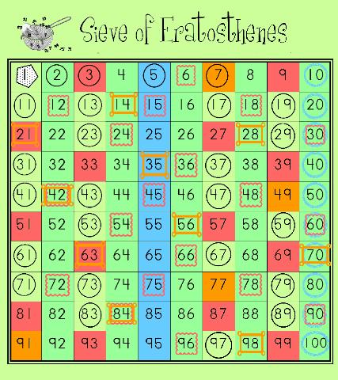

Slide 4


Slide 5
EU tech company
Hungarian multi
Emarsys - meetup & conference speaker - Mathematics MSc @ELTE
Ildi
Ildi
Ildi - meetup & conference speaker - Mathematics MSc @ELTE

Slide 6


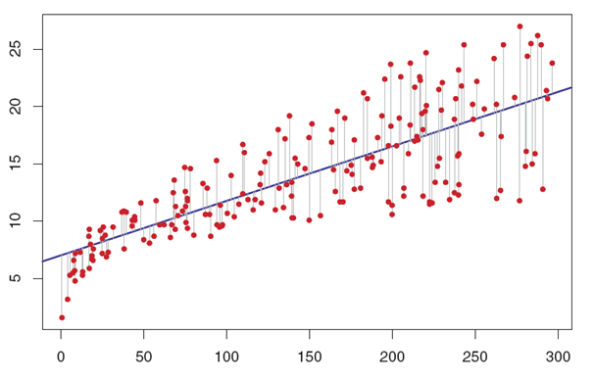

Slide 7



2015 Oct
2018 May
launch 📝
review for
Budapest BI forum
ERUM
unconf

Slide 8

bring in new tech
📦

Slide 9
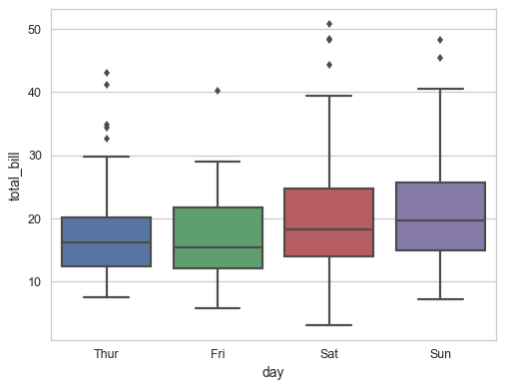
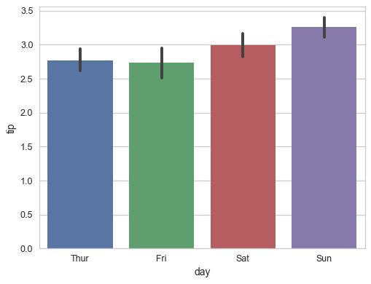
explain to non-tech

Slide 10
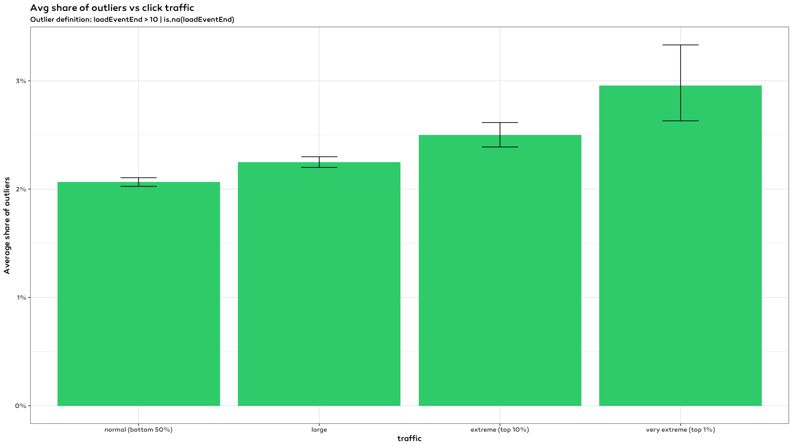
adapt methods

